Slide 1
Tailwind CSS
Dr. Shruti Bhilare

Slide 2
Motivation: framework
Writing raw CSS can be repetitive & time-consuming
Hard to maintain large stylesheets
Inconsistent design across components
Frameworks provide:
Predefined utilities
Faster prototyping
Consistent UI

Slide 3
Philosophy of Tailwind CSS
Rapidly build modern websites without ever leaving your HTML.
Utility-first approach → small, single-purpose classes
Focus on composition, not pre-styled components
Build custom designs without leaving HTML
Not opinionated about design

Slide 4
Contradicts the guideline
Traditional rule: “Keep HTML and CSS separate”
Tailwind mixes styling into HTML via utility classes
But:
Removes need for long CSS files
Reduces context switching (HTML ↔ CSS)
Enables design consistency across app

Slide 5
Other players in the market
Bootstrap → Component-based, “Bootstrap look”
Bulma → Flexbox-based, minimal, has components
Materialize → Based on Google Material Design
Foundation → Responsive grid + UI kit
Tailwind → Pure utility classes, highly customizable

Slide 6
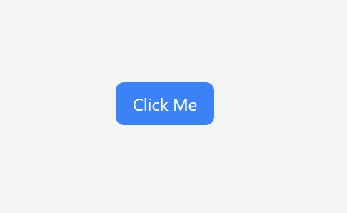
Example 1: styling requirement
Create a button with:
Blue background
White text
Horizontal padding (left & right)
Vertical padding (top & bottom)
Rounded corners
Darker blue background on hover

Slide 7
Traditional vs Tailwind CSS
/* Normal CSS to replicate the same Tailwind design */
.custom-btn {
background-color: #3B82F6; /* Tailwind bg-blue-500 */
color: white; /* Tailwind text-white */
padding: 0.5rem 1rem; /* Tailwind px-4 py-2 */
border-radius: 0.5rem; /* Tailwind rounded-lg */
}
.custom-btn:hover {
background-color: #1D4ED8; /* Tailwind hover:bg-blue-700 */
}
<button class="bg-blue-500 text-white px-4 py-2 rounded-lg hover:bg-blue-700">
Click Me
</button>

Slide 8
utility class
Each utility class in Tailwind CSS corresponds to a single CSS property. For example:
text-center aligns text to the center.
bg-blue-500 sets the background color to a specific shade of blue.
p-4 applies padding on all sides.

Slide 9
Spacing utilities
Margin: Sets margin on all sides or specific sides.
m-{side}-{size}
where {side} is optional and {size} corresponds to predefined spacing values.
Example: m-{size}, mt-{size}, mr-{size}, mb-{size}, ml-{size}, mx-{size}, my-{size}
m-{size}: Applies margin to all sides. E.g., m-4 applies 1rem margin on all sides.
mr-{size}: Applies margin to the right. E.g., mr-4 applies 1rem margin on the right.
Padding: Sets padding on all sides or specific sides.
p{side}-{size}
where {side} is optional and {size} corresponds to predefined spacing values.
Example: p-{size}, pt-{size}, pr-{size}, pb-{size}, pl-{size}, px-{size}, py-{size}
p-{size}: Applies padding to all sides. E.g., p-4 applies 1rem padding on all sides.
pb-{size}: Applies padding to the bottom. E.g., pb-4 applies 1rem padding on the bottom

Slide 10
Spacing scale
Tailwind CSS uses a spacing scale that usually includes values ranging from 0 to 96 and beyond. Here’s a typical scale you might find in Tailwind CSS:
margin | space
m-0: | 0 (no margin)
m-1 | 0.25rem (4px)
m-2 | 0.5rem (8px)
m-3 | 0.75rem (12px)
m-4 | 1rem (16px)
m-8 | 2rem (32px)
m-12 | 3rem (48px)
m-16 | 4rem (64px)
m-64 | 16 rem or 256px
1 rem is usually equal to 16 pixels (px): most browsers set the HTML's root font size to 16 px by default.

Slide 11
Color Palette
Tailwind CSS provides a comprehensive color palette that includes:
Grayscale: gray-100, gray-200, gray-300, ..., gray-900
Primary Colors: red-100, blue-100, green-100, ..., yellow-100
Accent Colors: purple-100, pink-100, teal-100, etc.
The colors are named with shades ranging from 100 (lightest) to 900 (darkest), allowing you to choose the exact shade you need.

Slide 12
Responsive Design
Tailwind also supports responsive design and variants via additional classes:
md:bg-green-500: Applies a green background color on medium-sized screens and larger.
hover:text-red-500: Changes the text color to red on hover.
Responsive Design
Tailwind CSS includes responsive variants for different screen sizes. Use prefix classes to apply styles at different breakpoints:
sm: for small screens (min-width: 640px)
md: for medium screens (min-width: 768px)
lg: for large screens (min-width: 1024px)
xl: for extra-large screens (min-width: 1280px)
2xl: for 2x extra-large screens (min-width: 1536px)

Slide 13
Tailwind CSS supports responsive variants and state variants (like hover, focus, etc.) for colors.
<div class="bg-red-500 md:bg-blue-500 lg:bg-green-500 p-4">
Background color changes based on screen size.
</div>

Slide 14
Layout Utilities
Container: container
Sets max-width and horizontal padding for responsive layouts.
Box Sizing: box-border, box-content
Controls the box-sizing property.
Display: block, inline, inline-block, flex, grid, hidden
Controls the display property.

Slide 15
Flexbox Utilities
Flex Direction: flex-row, flex-row-reverse, flex-col, flex-col-reverse
Controls the direction of flex items.
Flex Wrap: flex-wrap, flex-wrap-reverse, flex-nowrap
Controls whether flex items wrap or not.
Align Items: items-start, items-end, items-center, items-baseline, items-stretch
Aligns flex items along the cross axis.
Justify Content: justify-start, justify-end, justify-center, justify-between, justify-around, justify-evenly
Aligns flex items along the main axis.
Flex: flex-1, flex-auto, flex-initial, flex-none
Controls how flex items grow and shrink.

Slide 16
Grid utilities
Grid Template Columns: grid-cols-1, grid-cols-2, grid-cols-3, ..., grid-cols-{n}
Defines the number of columns in a grid.
Grid Column Span: col-span-1, col-span-2, ..., col-span-{n}
Controls how many columns an element should span.
Grid Template Rows: grid-rows-1, grid-rows-2, grid-rows-3, ..., grid-rows-{n}
Defines the number of rows in a grid.
Grid Row Span: row-span-1, row-span-2, ..., row-span-{n}
Controls how many rows an element should span.

Slide 17
Border utilities
Border Width: border, border-0, border-2, border-4, border-8
Sets the border width.
Border Color: border-{color}
Sets the border color.
Border Radius: rounded, rounded-sm, rounded-md, rounded-lg, rounded-xl, rounded-2xl, rounded-full
Sets the border radius.
Border Style: border-solid, border-dashed, border-dotted
Sets the border style.

Slide 18
Sizing utilities
Width: Sets the width of an element.
w-{size}, w-auto, w-full, w-screen
E.g., w-1/2 sets the width to 50% of the parent container.
Height: Sets the height of an element.
h-{size}, h-auto, h-full, h-screen
Max Width: Sets the maximum width of an element.
max-w-xs, max-w-sm, max-w-md, max-w-lg, max-w-xl, max-w-full
Max Height: Sets the maximum height of an element.
max-h-screen, max-h-full

Slide 19
Typography utilities
Font Size: Sets the font size.
text-xs, text-sm, text-base, text-lg, text-xl, ..., text-9xl
Font Weight: Sets the font weight.
font-thin, font-extralight, font-light, font-normal, font-medium,
font-semibold, font-bold, font-extrabold, font-black
Line Height: Sets the line height.
leading-none, leading-tight, leading-snug, leading-normal, leading-relaxed, leading-loose
Text Color: Sets the text color.
text-{color}
Text Alignment: Sets the text alignment.
text-left, text-center, text-right, text-justify

Slide 20
Background utilities
Background Color: bg-{color}
Sets the background color.
Background Position: bg-top, bg-center, bg-bottom, bg-left, bg-right
Sets the position of the background image.
Background Size: bg-cover, bg-contain, bg-auto
Sets the size of the background image.
Background Repeat: bg-repeat, bg-no-repeat, bg-repeat-x, bg-repeat-y
Sets the repeat behavior of the background image.

Slide 21
Shadow utilities
Box Shadow: shadow-sm, shadow, shadow-md, shadow-lg, shadow-xl, shadow-2xl, shadow-inner, shadow-outline
Adds shadow effects to elements.

Slide 22
Positioning utilities
Position: static, relative, absolute, fixed, sticky
Sets the positioning of an element.
Top/Right/Bottom/Left: top-{size}, right-{size}, bottom-{size}, left-{size}
Sets the offset from the edges of the positioned container.
Z-Index: z-{index}
Controls the stacking order of elements.

Slide 23
Transition and Animation Utilities
Transition Property: transition-all, transition-none, transition-colors, transition-opacity, transition-transform
Sets which properties should transition.
Animation: animate-spin, animate-ping, animate-pulse, animate-bounce
Applies predefined animations to elements.

Slide 24
Miscellaneous utilities
Opacity: opacity-{value}
Controls the opacity of elements.
Visibility: visible, invisible
Controls the visibility of elements.
Overflow: overflow-auto, overflow-hidden, overflow-visible, overflow-scroll
Controls the overflow behavior of elements.
Cursor: cursor-pointer, cursor-default, cursor-wait, cursor-text, cursor-move
Controls the cursor type on hover.

Slide 25
Setting up

Slide 26
Setting Up Tailwind CSS
Before you start writing Tailwind CSS, you need to set it up in your project. You can do this in a few different ways:
Installation steps
Via Play CDN:
For quick prototyping, you can include Tailwind CSS via a CDN in your HTML file
No installation required, in-browser support
<link href="https://cdn.jsdelivr.net/npm/tailwindcss@3.2.4/dist/tailwind.min.css" rel="stylesheet">
Fine for development purpose on a smaller scale, not the best choice for production.

Slide 27
Installation
Tailwind CSS works by scanning all of your HTML files, JavaScript components, and any other templates for class names, generating the corresponding styles and then writing them to a static CSS file.
Installation steps
CSS files
(input)
Tailwind
CSS file (output)

Slide 28
Installation steps
Step 1: Install tailwind CSS via npm
npm install -D tailwindcss
Step 2: Create your tailwind.config.js file
npx tailwindcss init
Step 3: Configure your template paths in tailwind.config.js file
/** @type {import('tailwindcss').Config} */
module.exports = {
content: ["./src/**/*.{html,js}"],
theme: {
extend: {},
},
plugins: [],
}

Slide 29
Template paths
Tailwind CSS generates utility classes based on the content it scans. By specifying template paths, you're telling Tailwind where to look for these utility class names in your project.
This is important because Tailwind uses this information to:
Identify Used Classes: Tailwind scans the files specified in the template paths to identify which classes are being used.
Remove Unused CSS: During the build process, Tailwind will only include the CSS for the classes that it finds in the specified paths. This results in a much smaller final CSS file compared to including all possible styles. (Purge mechanism)
You configure template paths in the tailwind.config.js file using the content property. Here’s a basic example:

Slide 30
Content property in config.js
/** @type {import('tailwindcss').Config} */
module.exports = {
content: [
"./index.html",
"./src/**/*.{js,ts,jsx,tsx}",
],
theme: {
extend: { },
},
plugins: [],
}

Slide 31
Configuration file: tailwind.config.js
The tailwind.config.js file is the configuration file for Tailwind CSS, allowing you to customize various aspects of Tailwind’s behavior. Here’s a breakdown of the key components and sections you can find or include in this configuration file:
// tailwind.config.js
module.exports = {
content: [
'./src/**/*.{js,jsx,ts,tsx}', // Specify where Tailwind should look for class names
],
theme: {
extend: {}, // Extend or override the default theme
},
plugins: [], // Add custom plugins or use third-party plugins
}

Slide 32
Configuration file
Content: This property specifies the paths to all of your template files where Tailwind CSS will look for class names.
It's crucial for Tailwind's purge mechanism to work efficiently.
Theme: This section is used to add or extend (customize) various aspects of the default Tailwind themes (utilities).
Custom Colors, custom Spacing, breakpoints
Extends: Within the theme section, extends is used to add new values to the default Tailwind configuration without overriding it.
Plugins: This section is where you can include custom plugins or third-party plugins to extend Tailwind’s functionality.
Safelist: Specify classes to always include in the final CSS, even if they are not found in your template files. Ensure certain classes are not purged, which can be useful for dynamically generated content.

Slide 33
Customizing the theme: extend colors, fonts, spacing
module.exports = {
theme: {
extend: {
colors: {
brand: "#1DA1F2",
},
fontFamily: {
heading: ["Poppins", "sans-serif"],
},
spacing: {
72: "18rem",
84: "21rem",
},
},
}
}

Slide 34
Plugins in TailwindCSS
A plugin in Tailwind CSS is an extension mechanism that lets you add new features, utilities, components, or variants beyond what Tailwind provides out of the box.
Common use case: install and use a plugin
npm install @tailwindcss/typography
Tailwind.config.js
// tailwind.config.js
module.exports = {
theme: {
extend: {},
},
plugins: [
require('@tailwindcss/typography'),
],
}
//HTML
<article class="prose">
<h1>Hello World</h1>
<p>This paragraph is styled by Tailwind Typography plugin.
</p>
</article>

Slide 35
Config file and usage
module.exports = {
theme: {
extend: {},
},
plugins: [
require('@tailwindcss/typography'),
require('@tailwindcss/forms'),
],
}
<article class="prose lg:prose-xl">
<h1>Introducing Tailwind Typography</h1>
<p>
This plugin makes your text look amazing without writing extra CSS.
</p>
<blockquote>
"Typography is the craft of endowing human language with a durable visual form."
</blockquote>
</article>

Slide 36
Installation steps
Step 4: Add Tailwind directives to your input CSS file
Step 5: Start the Tailwind CLI build process
npx tailwindcss -i ./src/input.css -o ./src/output.css --watch
Scans template paths for classes and builds css
Step 6: Start using Tailwind in your HTML
Add compiled css file to <head>
<link href="./output.css" rel="stylesheet">
// input.css
@tailwind base;
@tailwind components;
@tailwind utilities;

Slide 37
Tailwind directives
In Tailwind CSS, directives are special commands that you include in your CSS files to generate utility classes and manage how Tailwind CSS should apply its styles.
These directives are processed by Tailwind to include the necessary styles in your final CSS output.
Common Tailwind CSS Directives
@tailwind
@layer
@apply
@variants
@screen

Slide 38
@tailwind directive
@tailwind: This directive is used to include Tailwind’s base, components, and utilities styles into your CSS file. It tells Tailwind to generate and inject the corresponding styles into the output CSS.
@tailwind base;: Includes Tailwind’s base styles, which include CSS resets and normalization styles.
@tailwind components;: Includes pre-designed component styles from Tailwind, such as buttons, forms, and cards, if you're using any Tailwind plugin that provides these components.
@tailwind utilities;: Includes the utility classes for spacing, typography, colors, and other CSS properties.

Slide 39
Layers in Tailwind CSS
Tailwind CSS has a layering system that helps organize and control the order in which CSS is applied - specificity
Tailwind defines three main layers:
Base → resets or base element styles → lowest specificity
Components → reusable custom classes → medium
Utilities → single-purpose classes, → highest (can override others)
Example conflict:
What will be background color of the button?
Utilities override components, therefore, red
@layer components {
.btn { background: green; }
}
<button class="btn bg-red-500">Click</button>

Slide 40
Base Layer (@tailwind base)
Includes Tailwind’s preflight (a modified version of normalize.css).
Resets default browser styles (so things look consistent across browsers).
Applies low-level base styles to HTML elements (like headings, lists, forms).
Example:@tailwind base;
Input.css
:@tailwind base
Output.css
h1 {
font-size: 2em;
font-weight: bold;
}
a {
color: inherit;
text-decoration: none;
}

Slide 41
Components Layer (@tailwind components)
For custom component classes (like buttons, cards, navbars).
Tailwind adds its prebuilt component classes (like container).
You can also add your own component styles here.
This creates a reusable .btn class you can use in your HTML.
Input.css
@tailwind components;
@layer components {
.btn {
@apply px-4 py-2 bg-blue-500 text-white rounded;
}
}
Output.css
<button class=“btn”>
Click Me
</button>

Slide 42
Utilities Layer (@tailwind utilities)
Includes all of Tailwind’s utility classes (p-4, flex, text-center, etc).
These are the atomic classes you actually use in your HTML.
Always loaded last, so they can override base and component styles.
Input.css
@tailwind utilities
Output.css
<button class="px-4 py-2 bg-blue-500 text-white rounded"> Click Me
</button>

Slide 43
CSS reset files
Browsers apply their own default styles (margins, paddings, fonts).
This creates inconsistencies across Chrome, Firefox, Safari, etc.
Example: <h1> looks different in each browser.
CSS resets enable Cross-browser consistency.
Example: reset.css and normalize.css

Slide 44
Preflight
In Tailwind CSS, Preflight is the name for its built-in base styles.
It’s essentially a modified version of Normalize.css, plus some additional opinionated resets that make it easier to style elements consistently across browsers.
When you include Tailwind in your project, Preflight is automatically applied unless you disable it.
Resets browser inconsistencies
Removes default margins, paddings, and font sizes that browsers apply differently.
Normalizes heading, paragraph, and list element styles.
Enhances developer control
Removes opinionated styles (e.g., buttons no longer have default borders/shadows).
Makes sure everything is styled via Tailwind utilities, not browser defaults.

Slide 45
<h1>Hello World</h1>
<p>This is a paragraph</p>
<button>Click Me</button>
No preflight
With Tailwind Preflight
<h1> is bold, large, with margin applied.
<p> has margin.
<button> has default border, padding, background (varies by browser).
<h1> is unstyled (same size as normal text, no margin).
<p> has no margin.
<button> looks like plain text with clickable behavior (no border/background).
Disable preflight in tailwind.config.js
module.exports = {
corePlugins: {
preflight: false,
},
}

Slide 46
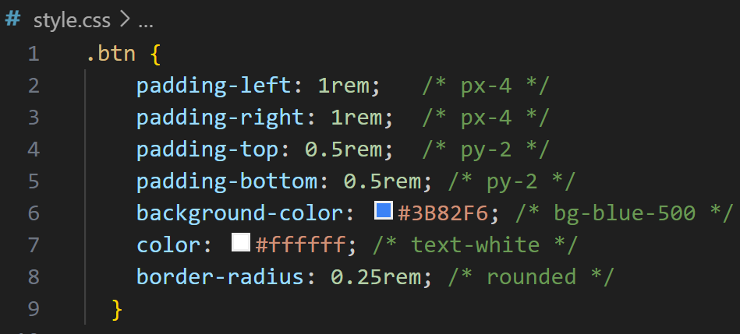
@apply directive
This directive allows you to apply Tailwind utility classes directly within your custom CSS classes. It is useful for creating custom styles that still leverage Tailwind’s utility classes.
//Input.css
.btn {
@apply px-4 py-2 bg-blue-500 text-white rounded;
}

Slide 47
@variants directive
This directive is used to create variants of your utilities based on different states or conditions. It's useful for customizing utility classes for different states like hover, focus, or responsive breakpoints.
@variants hover {
.btn {
@apply bg-blue-700;
}
}

Slide 48
@screen directive
This directive allows you to apply utility classes based on responsive breakpoints. It's used to target different screen sizes for responsive design.
@screen md {
.container {
@apply mx-auto max-w-screen-md;
}
}
For medium sized screens and up

Slide 49
@layer directive
This directive is used to define custom layers of styles in Tailwind. It allows you to add your own styles to Tailwind’s base, components, or utilities layers.
@layer components {
.btn {
@apply px-4 py-2 bg-blue-500 text-white rounded;
}
}
In this case, @layer components adds a custom .btn class to the components layer, making it part of Tailwind’s component styles.

Slide 50
Customization
While Tailwind provides a comprehensive set of utility classes out of the box, you can customize the framework by modifying the tailwind.config.js file.
Add custom colors, fonts, spacing, or components, utilities, themes, or responsive breakpoints according to your needs.

Slide 51
@apply directive
The @apply directive in Tailwind CSS is a powerful feature that allows you to apply utility classes directly in your CSS files or within your component styles.
It’s useful for when you want to create custom styles or apply multiple utility classes to a single CSS rule.
The @apply directive helps you to maintain a clean and manageable CSS codebase by allowing you to use Tailwind utility classes within your own custom CSS rules.

Slide 52
Drawbacks of Tailwind
Too many classes
HTML Bloat: Your HTML files can become cluttered with numerous classes, which can be harder to read and maintain.
Difficulty in Debugging: Finding the source of specific styles or understanding the full styling of an element can be more challenging with many utility classes.
Overriding Styles: Custom designs might require adding extra classes or using @apply in your CSS, which can lead to additional complexity.

Slide 53
Best Practices
Compose Classes: Combine multiple utility classes to achieve the desired design.
Use Responsive Utilities: Apply different styles for various screen sizes using responsive prefixes.
Customize as Needed: Tailwind is highly customizable; adjust the configuration to match your design requirements.

Slide 54
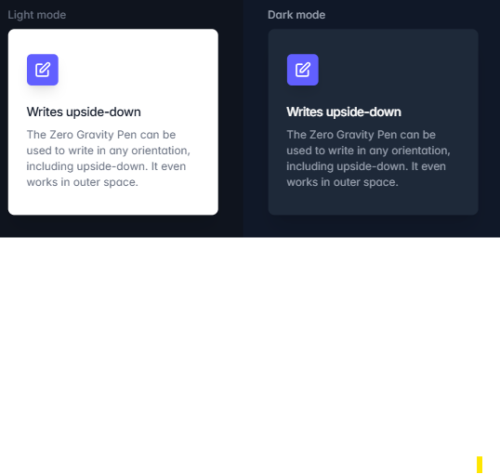
Dark mode
Great OS- support for dark mode these days, becomes important to create a dark version of the website to go along with the default design.
To make this as easy as possible, Tailwind includes a dark variant that lets you style your site differently when dark mode is enabled:

Slide 55
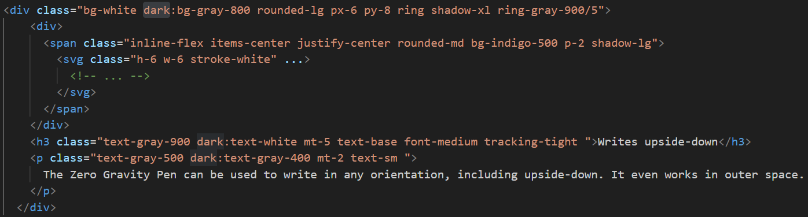

Slide 56
Recommended class order using prettier-plugin-tailwindcss
This plugin scans your templates for class attributes containing Tailwind CSS classes, and then sorts those classes automatically following our recommended class order.
<!-- Before -->
<button class="text-white px-4 sm:px-8 py-2 sm:py-3 bg-sky-700 hover:bg-sky-800">...</button>
<!-- After -->
<button class="bg-sky-700 px-4 py-2 text-white hover:bg-sky-800 sm:px-8 sm:py-3">...</button>

Slide 57
Recommended class order using prettier-plugin-tailwindcss
To get started, install prettier-plugin-tailwindcss as a dev-dependency on teminal:
npm install -D prettier prettier-plugin-tailwindcss
Then add the plugin to your Prettier configuration file:
{
"plugins": ["prettier-plugin-tailwindcss"]
}
any classes in the base layer will be sorted first, followed by classes in the components layer, and then finally classes in the utilities layer.
any utility classes that override other classes always appear later in the class list:

Slide 58
How to add a custom component?
Use the @layer components directive in your CSS file.
Combine utilities with @apply to define reusable UI pieces.
/* src/index.css */
@import "tailwindcss";
/* Define a custom button component */
@component btn {
@apply px-4 py-2 rounded-lg font-semibold text-white bg-blue-600 hover:bg-blue-700;
}
/* Another custom component: card */
@component card {
@apply p-6 rounded-2xl shadow-md bg-white border border-gray-200;
}

Slide 59
How to add a custom utility
Using the @utility directive
/* src/index.css or any CSS file included in your project */
@import "tailwindcss";
@utility text-shadow {
text-shadow: 2px 2px 4px rgba(0, 0, 0, 0.25);
}
@utility rotate-y-180 {
transform: rotateY(180deg);
}

Slide 60
How to use third party plugins
Install plugin: npm install @tailwindcss/forms
Add to the config file
// tailwind.config.js
import forms from '@tailwindcss/forms'
export default {
content: [
'./src/**/*.{html,js,ts,jsx,tsx}',
'./public/**/*.html',
],
plugins: [
forms, // third-party plugin
],
}
/* src/index.css */
@import "tailwindcss";
@import "@tailwindcss/forms";
@config {
plugins: [
require('@tailwindcss/forms'),
];
}

Slide 61
Use in HTML
<form class="space-y-4 p-6 bg-gray-50 rounded-lg">
<input type="text" placeholder="Your name"
class="block w-full rounded-md border-gray-300 focus:border-indigo-500 focus:ring-indigo-500 sm:text-sm">
<button type="submit"
class="px-4 py-2 bg-indigo-600 text-white rounded-md hover:bg-indigo-700">
Submit
</button>
</form>

